Slide 1
Desktop Assistant for Gaming
Bailey Goins
Eren Bikmaz
Lehi Briggs
Morgan Anderson

Slide 2

Our Project
A general focus on the gaming demographic
Overlays
Controlling second screen with voice commands
Integration with popular software used by the gaming demographic
Notes:
Bailey (4 Minutes)

Slide 3

Sprint Goals
Combine codebase into a single working project
Operate PAL asynchronously (during gameplay)
Implement command recognition/execution system
Extend user interface with a user account, account preferences, and contact system
Improve product backlog and implement Git merge strategies
Notes:
Morgan (4 Minutes)

Slide 4

Sprint Results
PAL learned a few tricks
Automated Google and YouTube searching
Encapsulated commands as objects according to the command design pattern
PAL can operate while playing games
An updated UI
Issues Encountered
Web browser automation is tricky and time consuming
PAL takes priority over running applications
Interacting with online accounts poses security risks
Notes:
Lehi (4 Minutes)

Slide 5

Goals For Our Next Sprint
Teach PAL even more tricks
Extend command system to desktop applications
Recognize other PAL users as contacts
Operate PAL without needing to interact with the UI (Hey PAL)
Operate PAL without taking priority over windows and applications
Customize PAL’s UI according to user preferences
Make PAL more secure
Implement a more secure backend to protect user account information
Notes:
Eren (4 Minutes)

Slide 6
Demo
Accounts
GUI
Speech Engine

Slide 7
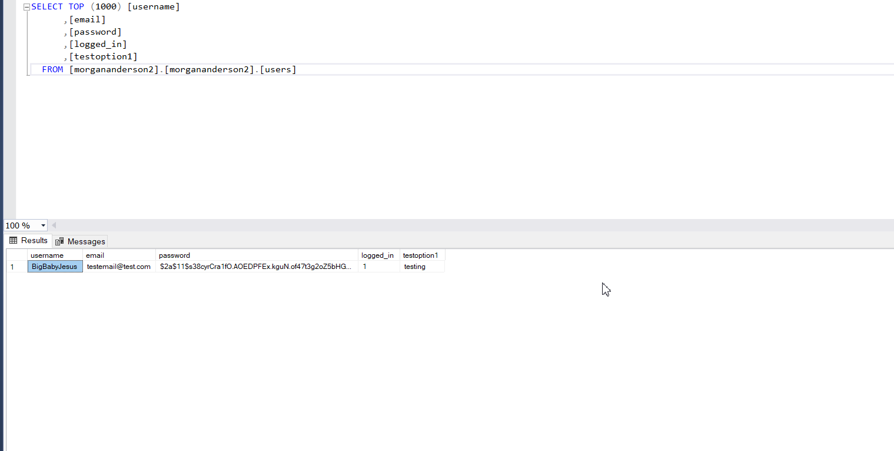
Accounts
Notes:
Morgan (3 Minutes)

Slide 8
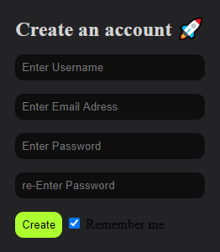
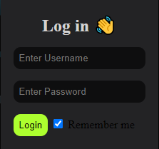
GUI
Notes:
Lehi (3 Minutes)

Slide 9
Speech Engine
Provide us with YouTube and Google search requests...
Notes:
Bailey Eren (5-10 Minutes)

Slide 10
Questions, Comments, Concerns?
Notes:
Bailey Delegation

